Slide 1



Slide 2
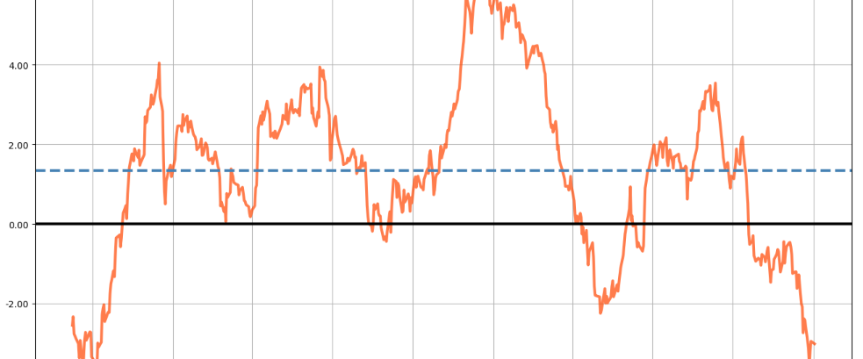
MHI based MDD optimized Portfolios
Performance Parameters of Portfolio
Exchange’s Market Health Index (MHI)
MHI based Optimized Portfolios

Slide 3
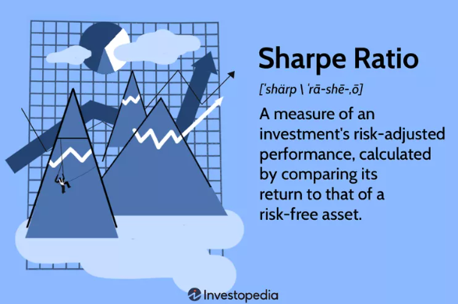
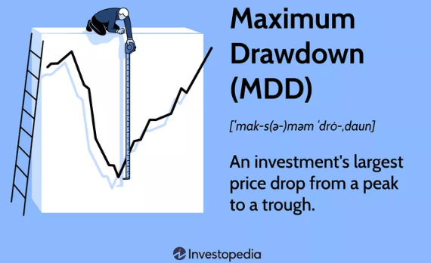
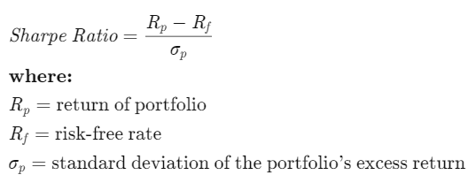

Some portfolio performance parameters
We try to maximize:
We try to minimize:

Slide 4
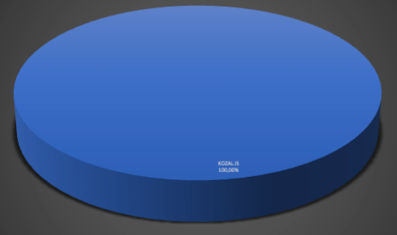
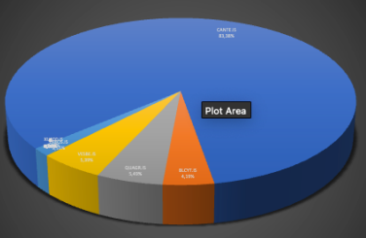
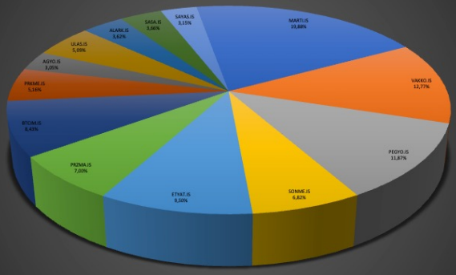
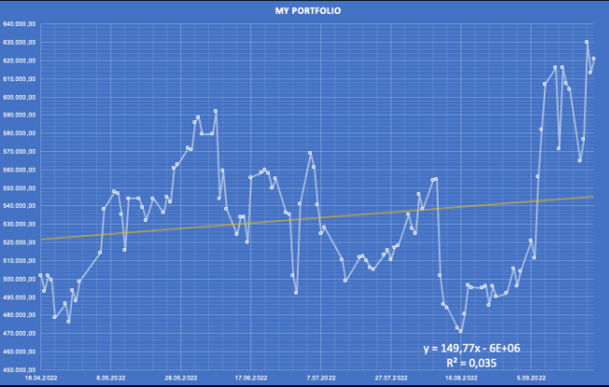
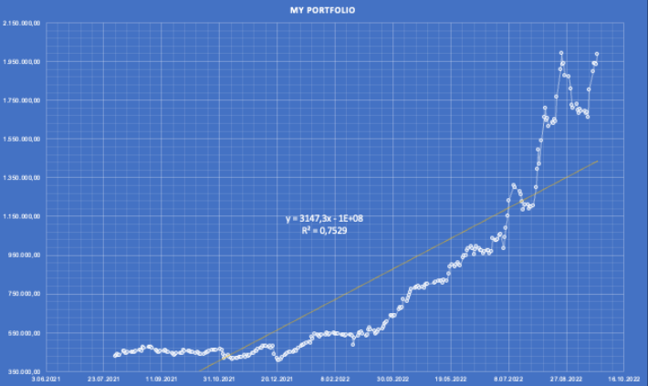
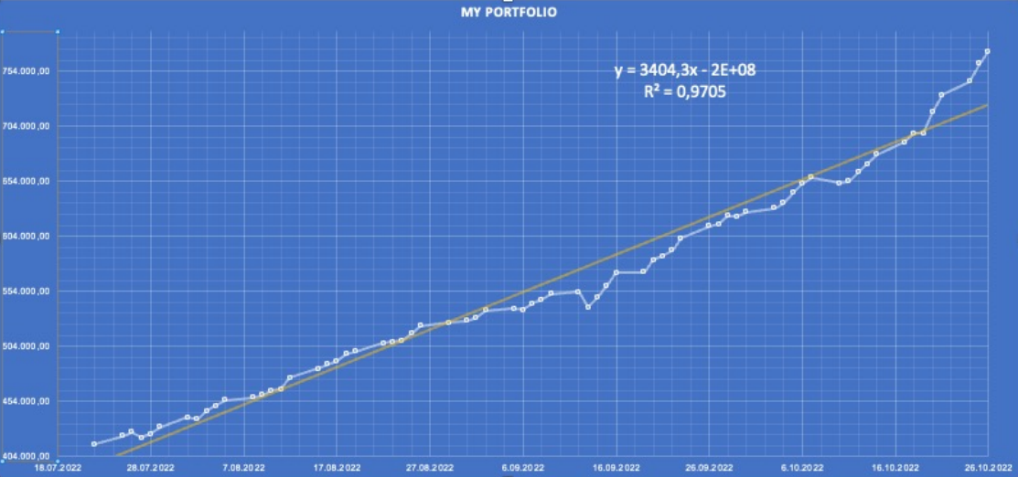
Performances of BIST Stock Exchange Portfolios
for similar time intervals
Single asset portfolio
5-asset Sharpe- optimized portfolio
17-asset MDD- optimized portfolio
Returns = %23.4
Stability = %2.53
Sharpe = 1.23
MDD = - %20.4
Returns = %364
Stability = %85
Sharpe = 3.61
MDD = -16.5 %
Period Returns = % 87.6
Stability = %98.7
Sharpe = 16.5
MDD = -2.56 %

Slide 5
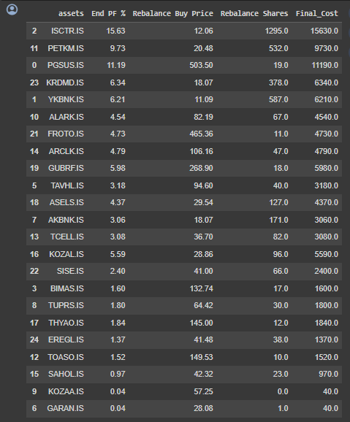
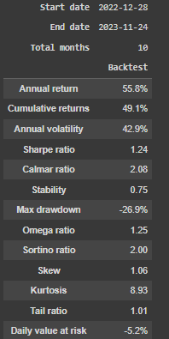
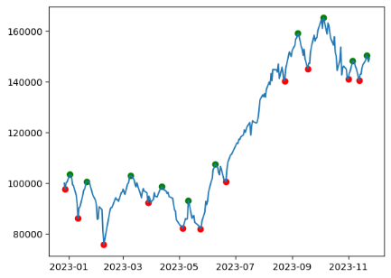
An optimized portfolio for 28.12.2022 – 24.12.2023

Slide 6
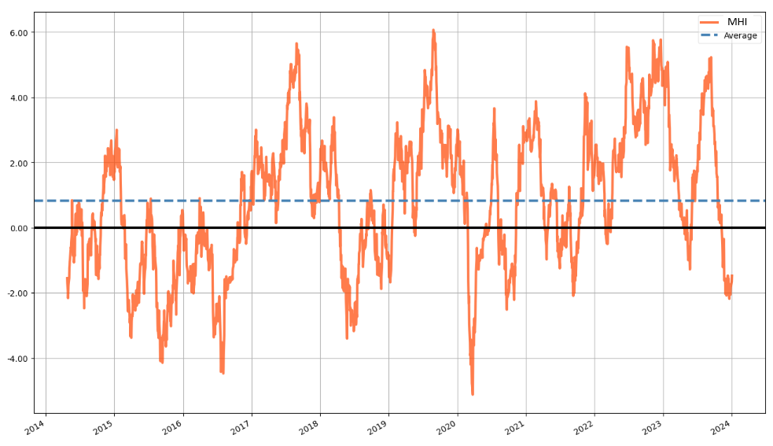
Market Health Index (MHI) for BIST30 - A mean-reverting index for trend detection

Slide 7
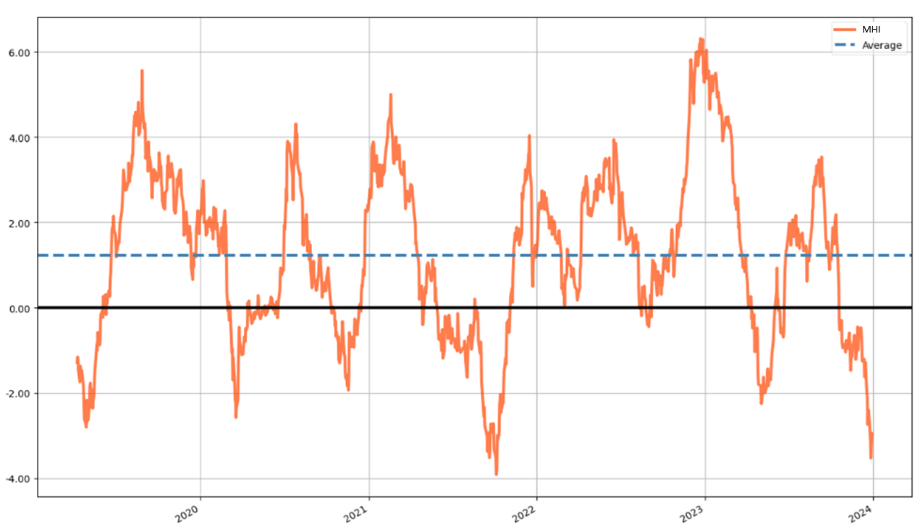
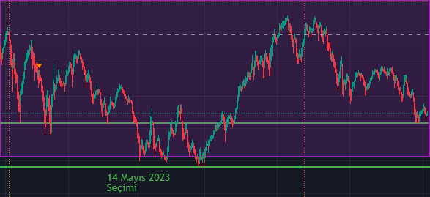
Market Health Index (MHI) - A mean-reverting index for trend detection
MHI on BIST30
Downtrend Uptrend
PREV UPTREND
23.08.2021 – 21.09.2022 21.09.2021 – 16.12.2021 (I)
16.12.2021 – 24.02.2022 24.02.2022 – 07.06.2022 (II)
07.06.2022 – 16.08.2022 16.08.2022 – 27.12.2022 (III)
27.12.2022 – 09.05.2023 09.05.2023 – 11.09.2023 (IV)
11.09.2023 – 26.11.2023 NEXT UPTREND
BIST100 – last 1 year
Last 5 years >>

Slide 8
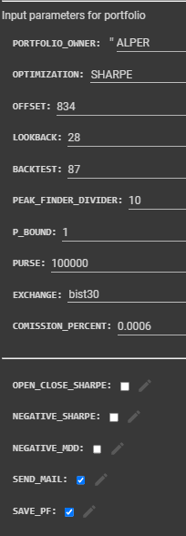
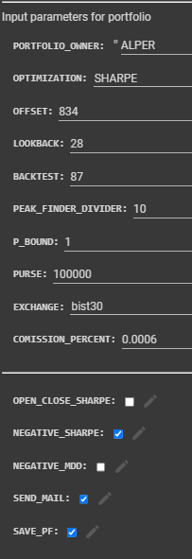
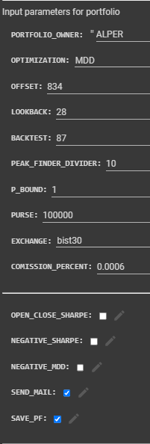
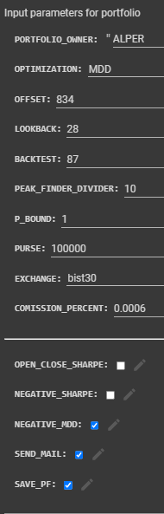
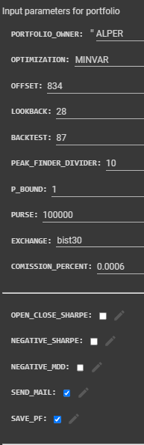
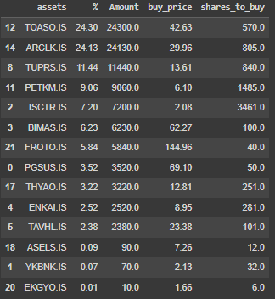

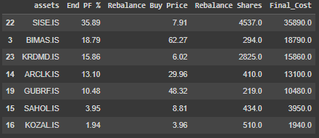

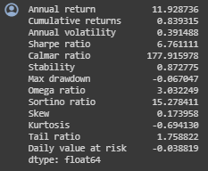
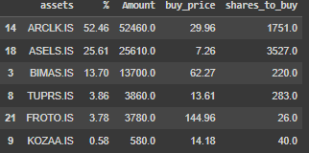
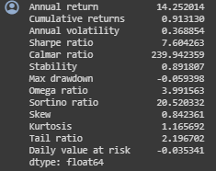
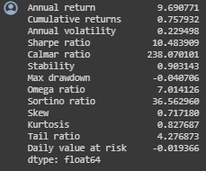
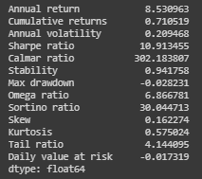
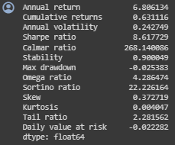
MHI portfolios for 21.09.2021 – 16.12.2021 (I)
Sharpe i-Sharpe MDD i-MDD MINVAR
Return: %91.3
SR: 7.6
MDD: %5.93
Calmar R: 240
Return: %83.9
SR: 6.76
MDD: %6.7
Calmar R: 178
Return: %75.8
SR: 10.48
MDD: %4
Calmar R: 238
Return: %71.1
SR: 10.91
MDD: %2.82
Calmar R: 302
Return: %63.1
SR: 8.61
MDD: %2.53
Calmar R: 268

Slide 9
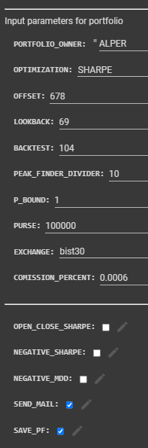
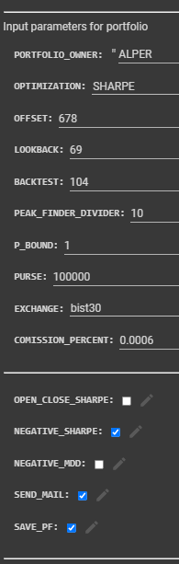
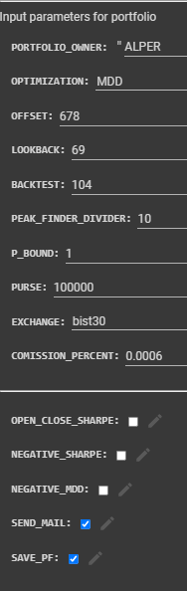
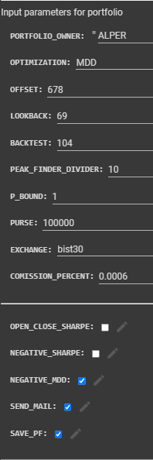
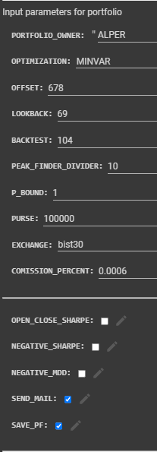

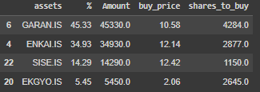


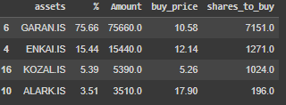
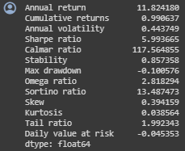
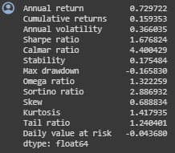
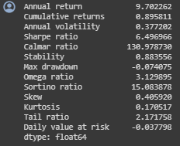
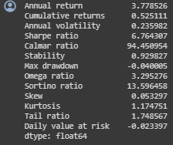
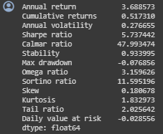
MHI portfolios for 24.02.2022 – 07.06.2022 (II)
Sharpe i-Sharpe MDD i-MDD MINVAR
Return: %99
SR: 5.99
MDD: %10.0
Calmar R: 117.6
Return: %15.93
SR: 1.67
MDD: %16.58
Calmar R: 4.4
Return: %89.6
SR: 6.49
MDD: %7.40
Calmar R: 131
Return: %52.5
SR: 6.76
MDD: %4.0
Calmar R: 94.5
Return: %51.7
SR: 5.73
MDD: %7.68
Calmar R: 48

Slide 10
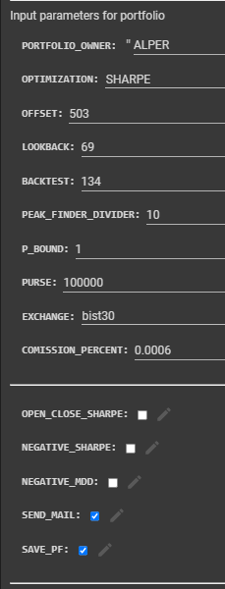
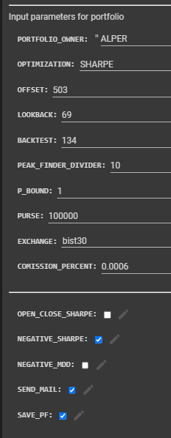
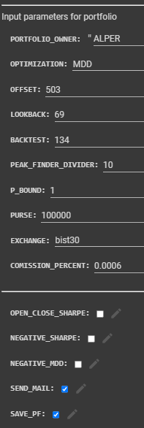
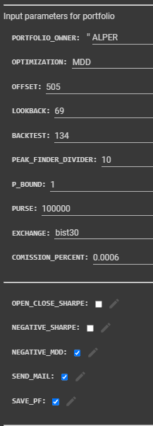
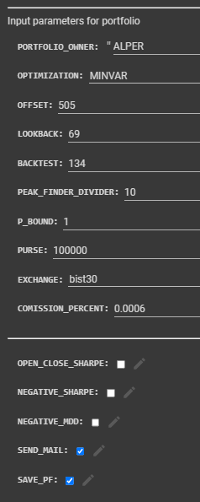
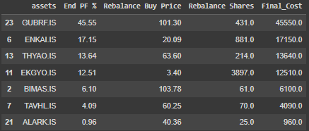
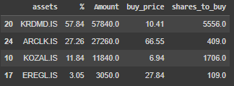
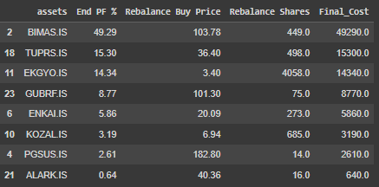

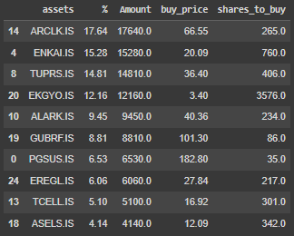





MHI portfolios for 16.08.2022 – 27.12.2022 (III)
Sharpe i-Sharpe MDD i-MDD MINVAR
Return: %73.7
SR: 2.76
MDD: %22.2
Return: %120
SR: 5.66
MDD: %7.2
Calmar R: 103
Return: %97.4
SR: 4.32
MDD: %17.4
Calmar R: 30.5
Return: %78.7
SR: 4.64
MDD: %9.9
Return: %95.5
SR: 5.96
MDD: %12.0

Slide 11















MHI portfolios for 09.05.2023 – 11.09.2023 (IV)
Sharpe i-Sharpe MDD i-MDD MINVAR
Return: %56.6
SR: 2.75
MDD: %13.7
Return: %65.6
SR: 3.39
MDD: %11.4
Return: %80.4
SR: 3.96
MDD: %16.1
Return: %64.3
SR: 3.96
MDD: %17.8
Return: %92.3
SR: 4.82
MDD: %12.4

Slide 12




Slide 13
Procedure for Portfolio Construction
Calculate and plot 5 year-MHI for at least 2 exchanges
Detect peaks (MHI > 4) and valleys (MHI < -2)
Apply Volatility and Correlation filters
At MHI < -2, start from latest peak, calculate best performing portfolio in downtrend, Enter that portfolio
At the first MHI > 4 , sell the portfolio and diverse to other exchange’s MHI < -2.

Slide 14

Filter for Correlation

Slide 15

Filter for Volatility

Slide 16

Our B2B Product:
AI assisted portfolios management with:
Entries-exits based on MHI of that exchange
Sharpe, i-Sharpe, MDD, i-MDD, MinVAR optimized
Correlation, volatility, fundamentals filtering
Multi-Exchange Consolidated returns
KAP news filter
Customer Positioning:
Investors with at least 16 month patience
Insurance, retiree funds
Retirees
MDD-optimized Multi-Exchange Portfolios with MHI alert

Slide 17

QUESTIONS ?

